Slide 1

Computer Vision Libraries, Frameworks, and IDEs
Exploring Tools for Vision Development
Notes:
In this presentation, we will explore various computer vision tools such as Jupyter Notebooks, Google Colab, AWS Sagemaker StudioLab, Azure Copilot, GitHub, and Hugging Face.

Slide 2
Mod 01 & 02 Recap
CV History and Enablers
Basic Principles
Technologies Impacting CV
CV Applications
CV Cameras
Specs
Calibration and setups
Sensors used in CV

Slide 3
This Module
Python Libraries & Frameworks
Jupyter Notebooks & Jupyter Labs
Local Development Environment:
Visual Code Studio
Cloud Base Development Environments
Google Colab
SageMaker Studio Lab
Azure AI
High Performance Computer
TACC
Code repositories and Collaboration Platforms
GitHub
Hugging Face

Slide 4

Introduction to Libraries and Frameworks
Libraries vs. Frameworks
Libraries and Frameworks are tools that help developers write efficient computer vision software.
Libraries are collections of pre-written code that developers can use to write their own software.
Frameworks, on the other hand, are more comprehensive and provide a structure for building software.
.
Notes:
Before we start to explore the various computer vision tools, we will provide an overview of Libraries and Frameworks used in computer vision, the differences between the two, and examples of popular Libraries and Frameworks.
Popular Libraries
OpenCV is a popular computer vision Library that is widely used in the industry. Other popular Libraries include DLIB and SimpleCV, which are also widely used for computer vision applications.
Popular Frameworks
TensorFlow and Keras are popular Frameworks used in computer vision for developing deep learning models. Other popular Frameworks include Caffe, Torch, and PyTorch.

Slide 5
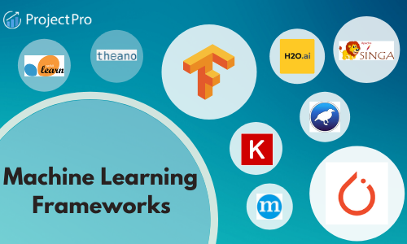
ML Frameworks
Collection of pre-built tools, libraries, and APIs that help developers create machine learning models and applications more efficiently
Keras: High-level neural networks API, written in Python
Benefits: Easy to use, integrates with TensorFlow
Fastai: Simplifies training fast and accurate neural nets using modern best practices
Focus: Transfer learning, easy-to-use abstractions
Caffe: Deep learning framework made with expression, speed, and modularity in mind
Application: Image classification, convolutional neural networks
Notes:
Machine Learning Frameworks:
These are software tools or libraries that provide a foundation for designing, training, and validating machine learning models. They offer a way to build and deploy machine learning models more efficiently and effectively, often by abstracting away some of the lower-level details.
Examples include: TensorFlow, PyTorch, Keras, Scikit-learn, and Caffe.
A framework can be seen as a kitchen equipped with tools and appliances that make it easier to follow the recipe (algorithm).

Slide 6
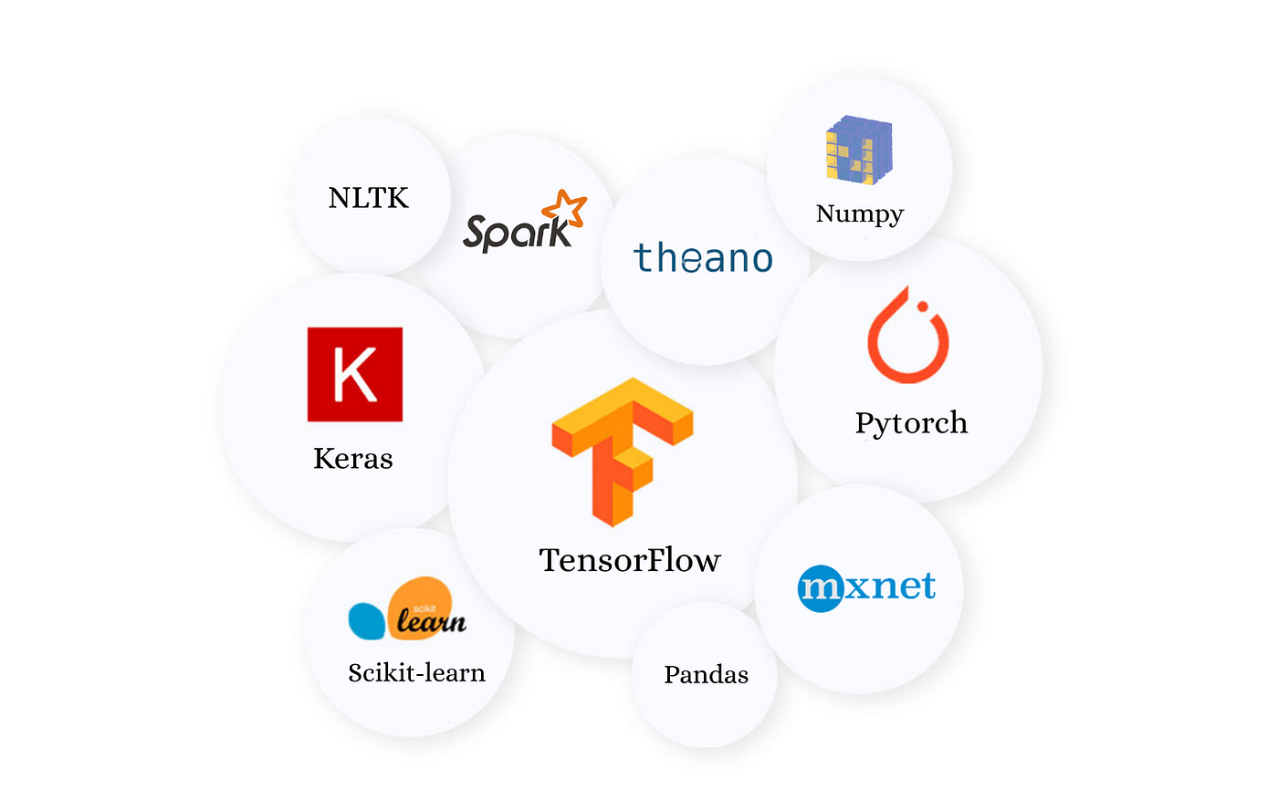
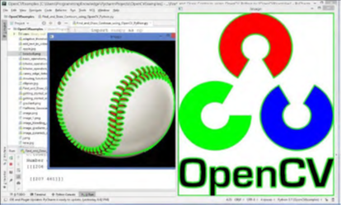
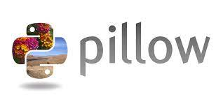

ML Libraries
Collections of functions and methods that allow you to perform many actions without writing your code from scratch.
Popular Computer Vision Libraries
OpenCV: Open Source Computer Vision Library
Functions: Image processing, object detection, feature extraction
TensorFlow: Open-source platform for machine learning
Features: Neural networks, deep learning models, scalability
PyTorch: Deep learning framework by Facebook
Strengths: Dynamic computation graph, strong community support
Notes:
Python Libraries:
In the context of machine learning, Python libraries are collections of functions and methods that allow you to perform many actions without writing your code from scratch. Some Python libraries are general-purpose (like NumPy for numerical computing or Pandas for data manipulation), while others are specialized for machine learning (like Scikit-learn).
Machine learning frameworks like TensorFlow and PyTorch are technically Python libraries as well, but they're often referred to as "frameworks" because they offer a more comprehensive suite of tools specifically designed for deep learning and machine learning tasks.
In the older days, people used to perform Machine Learning tasks by manually coding all the algorithms and mathematical and statistical formulas. This made the processing time-consuming, tedious, and inefficient. But in the modern days, it is become very much easy and more efficient compared to the olden days with various python libraries, frameworks, and modules. Today, Python is one of the most popular programming languages for this task and it has replaced many languages in the industry, one of the reasons is its vast collection of libraries. Python libraries that are used in Machine Learning are: The Gluon library, part of the Apache MXNet project, offers a wide range of tools and features designed to simplify the creation, training, and deployment of deep learning models, particularly in computer vision. Some of the key tools and features include:
Numpy
Scipy
Scikit-learn
Theano
TensorFlow
Keras
PyTorch
Pillow: Pillow is a popular, user-friendly library for opening, manipulating, and saving many different image file formats in Python. It is a fork of the Python Imaging Library (PIL).

Slide 7

Importance of Libraries and Frameworks
Accelerate Development: Provides pre-built components for rapid prototyping
Improve Accuracy: Access to state-of-the-art algorithms and models
Enhance Collaboration: Standardized tools and environments facilitate teamwork
Ensure Scalability: Designed to handle growing data and model complexities
Notes:
Libraries and frameworks are important tools in software development that provide pre-built components for rapid prototyping, access to state-of-the-art algorithms and models that improve accuracy, and standardized tools and environments that enhance collaboration. Additionally, they are designed to handle growing data and model complexities, ensuring scalability.

Slide 8
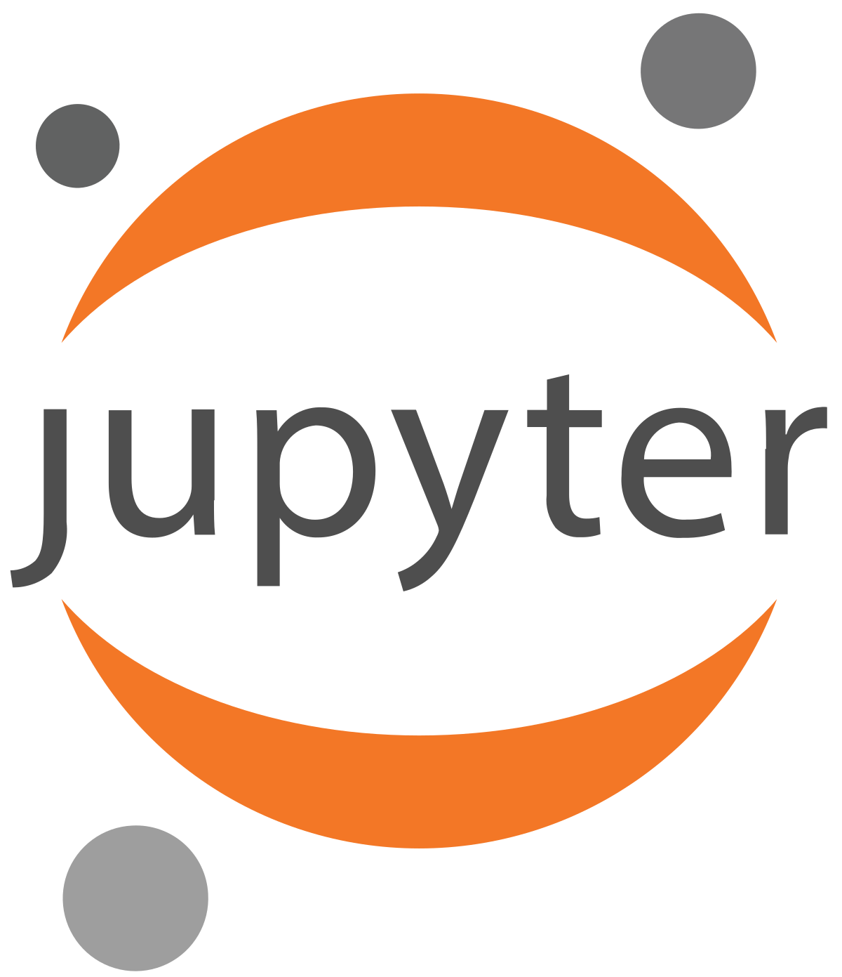
Jupyter Notebooks and Jupyter Labs
Jupyter Notebooks
Jupyter Notebooks is an open-source web application used for creating and sharing documents that include live code, visualizations, and text. It supports multiple programming languages and is widely used by researchers, data scientists, and educators.
Jupyter Labs
Jupyter Labs is the next-generation Jupyter Notebook interface that provides an integrated development environment for working with notebooks, code, and data. It offers a wide range of features such as code completion, debugging, and multiple notebook views.
Notes:
Jupyter Notebooks is an open-source web application that allows developers to create and share documents that include live code, equations, visualizations, and text. Jupyter Labs is the next-generation Jupyter Notebook interface that provides an integrated development environment for working with notebooks, code, and data. We will explore the features of both Jupyter Notebooks and Jupyter Labs, how to install them, and use them to create computer vision applications.
Installation
Installing Jupyter Notebooks and Jupyter Labs is easy and can be done using popular package managers such as conda or pip. It is also possible to install them using virtual environments.
Computer Vision Applications
Jupyter Notebooks and Jupyter Labs are great tools for creating computer vision applications. They allow developers to create interactive notebooks that include live code, visualizations, and text, making it easy to share and collaborate on projects.

Slide 9
IMPORTANT
Most computers at HCC have Python and Jupyter installed
You Can and Should install Python and Jupyter on your computer

Slide 10
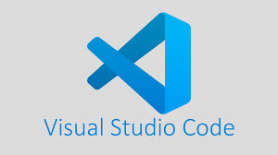
Local Development Tools
Visual Studio Code (VS Code) : free, open-source code editor developed by Microsoft.
Key Features:
IntelliSense: Code completion, syntax highlighting, and intelligent code navigation.
Extensions: Vast library of extensions for various programming languages and tools.
Integrated Terminal: Built-in terminal for running command-line operations within the editor.
Version Control: Git integration for version control and collaboration.
Debugging: Powerful debugging tools for multiple programming languages.
Benefits:
Customizability: Highly customizable to fit different development workflows.
Performance: Lightweight and efficient, suitable for large projects.
Community: Strong community support and regular updates.

Slide 11
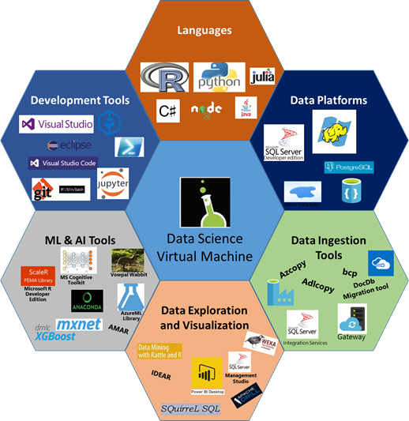
Integrated Development Environment (IDE)
IDE is a software application that provides a comprehensive set of tools for software development in a single interface
Purpose: Streamline development process, provide tools for debugging, visualization, and collaboration.
We will look at some in the next slides
Notes:
The term "environment" in this context refers to the digital workspace or platform that developers use to create and manage their software projects. It encompasses all the tools, features, and resources necessary for the development process. So, you can accurately refer to an IDE as an environment for software development.

Slide 12
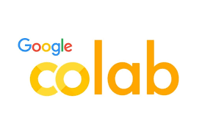
Google Colab
Cloud-Based Python Environment
Google Colab is a free cloud-based service that allows developers to write and run Python code collaboratively, without the need for installing software or hardware.
Computer Vision Applications
Google Colab can be used to create and run computer vision applications, using popular open-source python libraries such as OpenCV.
Data Preprocessing and Analysis
Google Colab can be used to load and preprocess data, and to analyze the data using popular python libraries such as Pandas and NumPy.
Model Training and Testing
Google Colab can be used to train and test models using popular open-source python libraries such as TensorFlow and Keras.
Notes:
Google Colab is a free cloud-based service that allows developers to write and run Python code collaboratively. We will explore how to use Google Colab to create and run computer vision applications, how to load and preprocess data, and how to train and test models using open-source python libraries.
Overview:
Free cloud service, supports GPU and TPU
Integrates with Google Drive
Features:
Pre-installed libraries, easy sharing, collaborative coding
Advantages:
No setup required, powerful computing resources

Slide 13
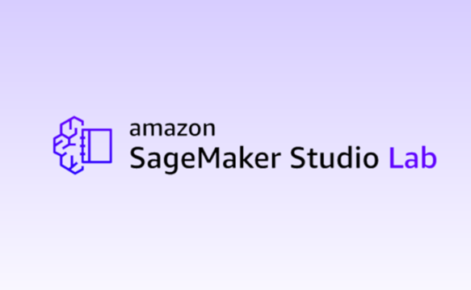
AWS Sagemaker StudioLab
AWS Sagemaker StudioLab
AWS Sagemaker StudioLab is a web-based integrated development environment (IDE) for machine learning
Features:
Free, no-setup environment to learn and experiment with machine learning.
Jupyter-based interface for interactive development.
Pre-configured environments for machine learning and deep learning.
Integrated tools for data preparation, model training, and deployment.
Notes:
AWS Sagemaker StudioLab is a web-based integrated development environment (IDE) for machine learning. We will explore how to use AWS Sagemaker StudioLab to create and deploy computer vision applications, how to use pre-built algorithms and models, and how to train and test custom models.

Slide 14
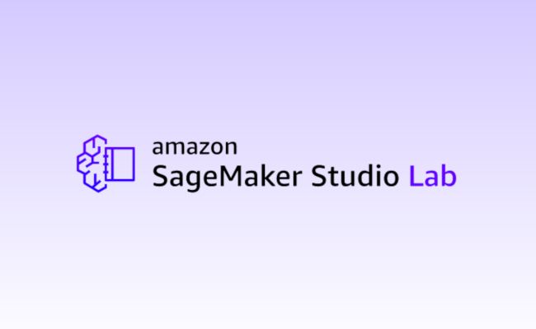
SageMaker Studio Lab
Request a Studio Lab account
Navigate to the Studio Lab landing page .
Select Request account.
Enter the required information into the form.
Select Submit request.
If you receive an email to verify your email address, follow the instructions in the email to complete this step.

Slide 15

Azure Copilot
What is Azure Copilot?
Azure Copilot is a set of tools and processes that help developers create and deploy container-based applications on Microsoft Azure.
Deploying a Computer Vision Application
Azure Copilot makes it easy to deploy a computer vision application on Microsoft Azure using pre-built models and APIs.
Deploying Custom Models
Developers can deploy custom models on Microsoft Azure using Azure Copilot, making it easy to scale and manage their machine learning models.
Notes:
Azure Copilot is a set of tools and processes that help developers create and deploy container-based applications on Microsoft Azure. We will explore how to deploy a computer vision application using Azure Copilot, how to use pre-built models, and how to deploy custom models.

Slide 16

High Performance Computer
Texas Advanced Computing Center (TACC) provides high-performance computing resources.
Key Features:
Cutting-edge supercomputers: Frontera, Stampede2
Massive storage systems, advanced data analysis tools
Benefits for AI and Computer Vision:
Accelerates large-scale computations, model training
Facilitates research and development with access to powerful infrastructure
Notes:
Efficiency: Pre-built functions and tools save time.
Standardization: Provides consistent methods for common tasks.
Community Support: Large user bases and extensive documentation.
Scalability: Designed to handle large datasets and complex models.
Interoperability: Integrates with other tools and platforms easily.

Slide 17

Code Repositories & Collaboration Platforms

Slide 18

Git & GitHub
GitHub Repositories
GitHub is widely used by developers to store and manage code repositories. It provides version control and collaboration tools that help developers work together effectively.
Computer Vision Code
GitHub can be used to manage computer vision code repositories. GitHub Copilot can assist developers in writing computer vision code by suggesting relevant code.
Collaboration with Other Developers
GitHub provides collaboration tools that enable developers to work together effectively. Developers can use GitHub Copilot to suggest different ways to write code and discuss code changes with other developers.
Notes:
GitHub is a web-based platform that enables developers to store and manage their code repositories. GitHub Copilot is an AI-powered code suggestion tool that assists developers in writing code. We will explore how to use GitHub to manage computer vision code repositories, how to use GitHub Copilot to write computer vision code, and how to collaborate with other developers using GitHub.

Slide 19

Hugging Face Advanced tools
Computer Vision Tools
Hugging Face provides state-of-the-art computer vision tools that enable users to build and train custom models for image recognition, object detection, and semantic segmentation.
Custom Model Building and Training
Users can use Hugging Face's computer vision tools to build and train custom models for their specific needs, including image classification, object detection, and semantic segmentation.
Integration with Other Computer Vision Tools
Hugging Face's computer vision tools can be easily integrated with other computer vision tools, such as TensorFlow and PyTorch, to enhance their performance and accuracy.
Notes:
Hugging Face is a company that provides natural language processing (NLP) and computer vision tools. We will explore Hugging Face's computer vision tools, how to use them to build and train custom models, and how to integrate them with other computer vision tools.

Slide 20
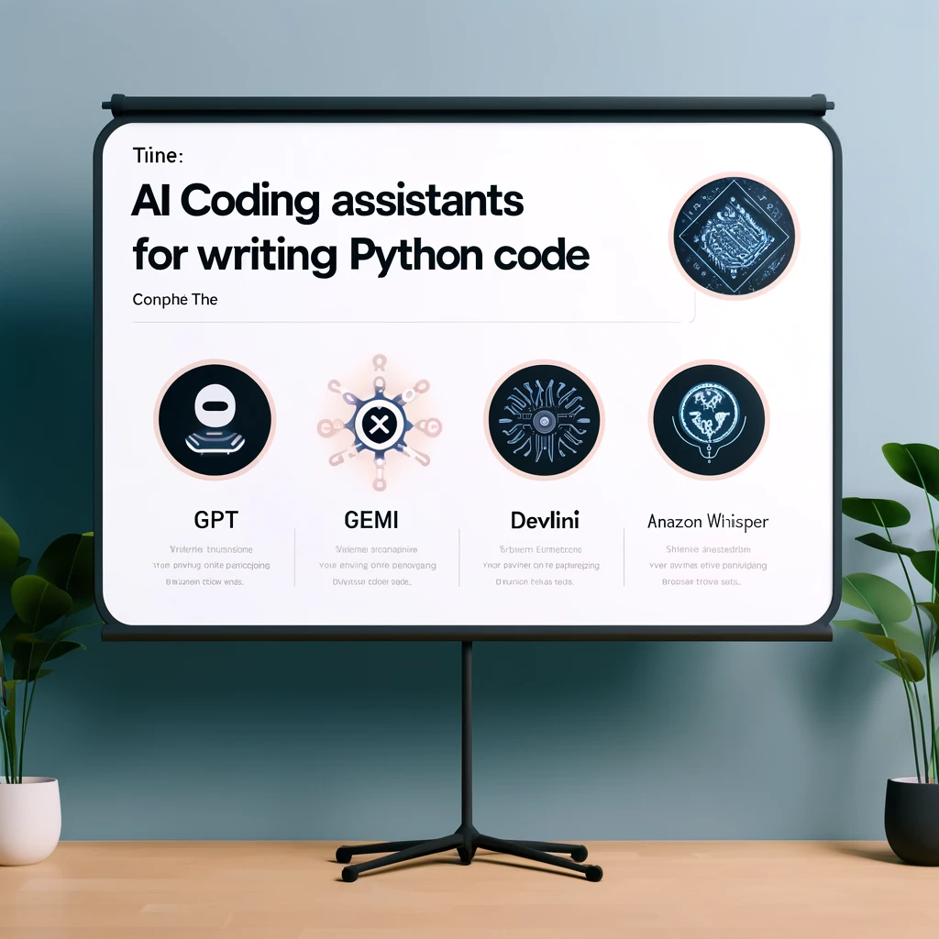
Coding Assistants
AI coding assistants are tools powered by artificial intelligence designed to help developers write code more efficiently.
They provide features such as code completion, error detection, code generation, and real-time suggestions.
These tools leverage machine learning models trained on vast amounts of code to understand and predict what developers intend to write.

Slide 21

Benefits of AI code Assistants
Increased Productivity: Automate repetitive coding tasks and provide instant code suggestions.
Reduced Errors: Assist in identifying and correcting coding errors.
Improved Learning: Help new developers understand and write code by providing contextual code snippets and explanations.
Enhanced Collaboration: Facilitate better code documentation and sharing among team members.

Slide 22
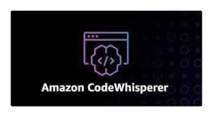
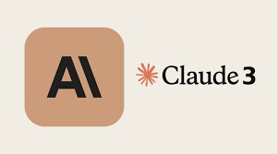
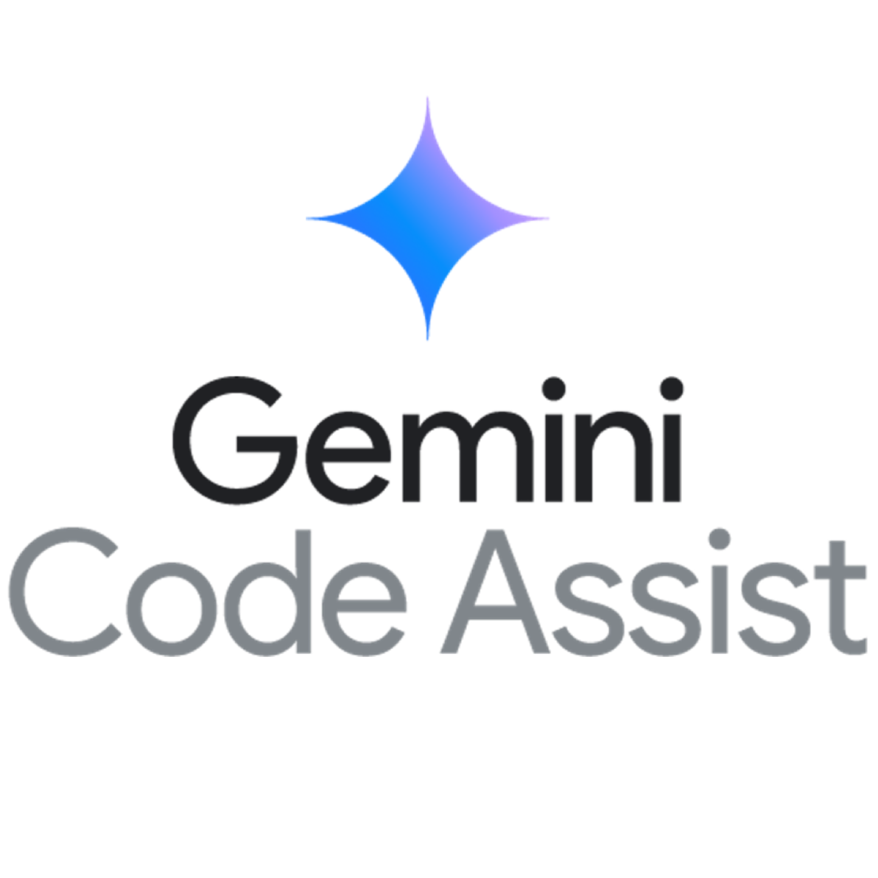
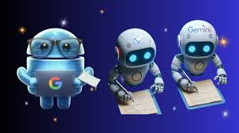
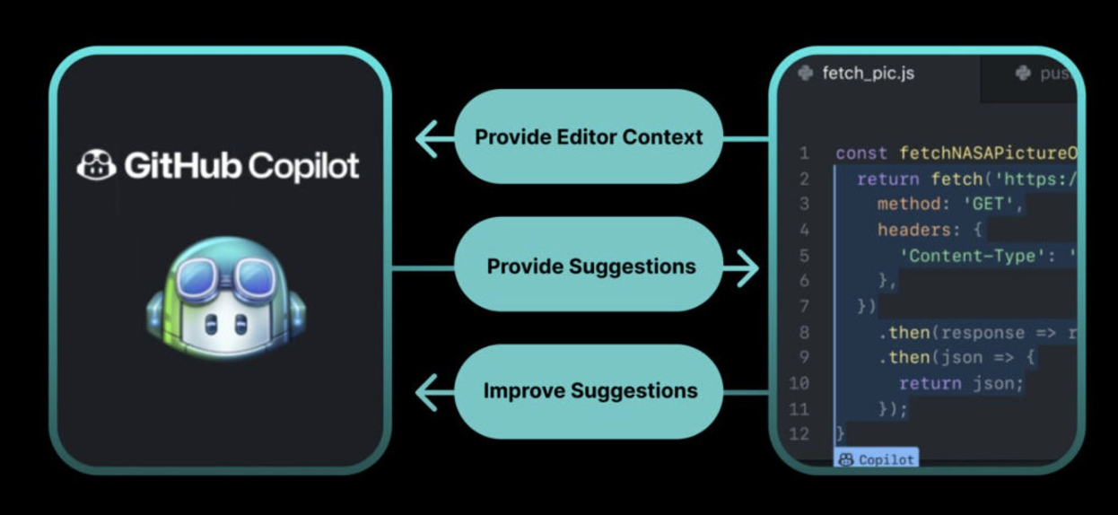
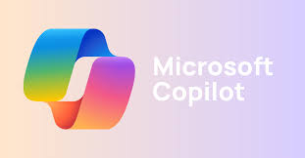
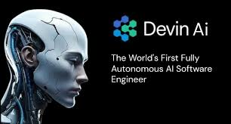
Examples of Available Code Assistants

Slide 23

Google Gemini Code
Gemini is an AI-driven code assistant designed to help developers write better code by providing intelligent suggestions, auto-completion, and error detection in real-time.
Integration: Works seamlessly with Colab and popular code editors and development environments, enhancing coding efficiency and accuracy.

Slide 24

GitHub Copilot
GitHub Copilot
Developed by GitHub and OpenAI, it is an AI-powered code completion tool that helps developers by suggesting whole lines or blocks of code based on the current context.
Features:
Contextual Suggestions: Provides code suggestions that match the context and style of the existing code.
Multi-Language Support: Supports various programming languages, including Python, JavaScript, TypeScript, Ruby, and Go.
Natural Language Queries: Can generate code from natural language comments, making it easier to translate ideas into code.
Integration: Works with Visual Studio Code, making it accessible to a large number of developers.

Slide 25
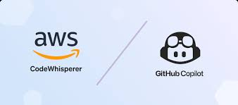

Amazon CodeWhisperer
AI-powered code companion that helps developers write code faster and with fewer errors by generating code suggestions based on natural language comments and existing code.
Integration: Seamlessly integrates into SageMaker, SageMaker Studio Lab and other popular IDEs and development environments, providing real-time code recommendations.

Slide 26



Gen AI Code Assistants Outside IDEs
Advanced AI models like GPT, Claude, and Devin can significantly enhance coding productivity by generating code, offering suggestions, and providing explanations outside traditional IDE integrations.
Benefits of Generative AI Outside of IDEs
Flexibility: Access AI capabilities from any device with internet access, without being tied to a specific development environment.
Custom Applications: Create tailored solutions and tools that leverage AI for specific coding tasks or workflows.
Learning and Exploration: Use AI models to experiment with new languages and frameworks, receiving guidance and suggestions in real-time.

Slide 27

Tutorials
Separate in-depth tutorial presentations about GitHub and Jupyter available
Embedded tutorials in this presentation on GitHub Copilot and GitHub
Notes:
This presentation contains embedded tutorials on various topics. For more detailed information, separate in-depth tutorial presentations about GitHub and Jupyter are available. Use these tutorials to expand your knowledge and understanding of these tools.

Slide 28
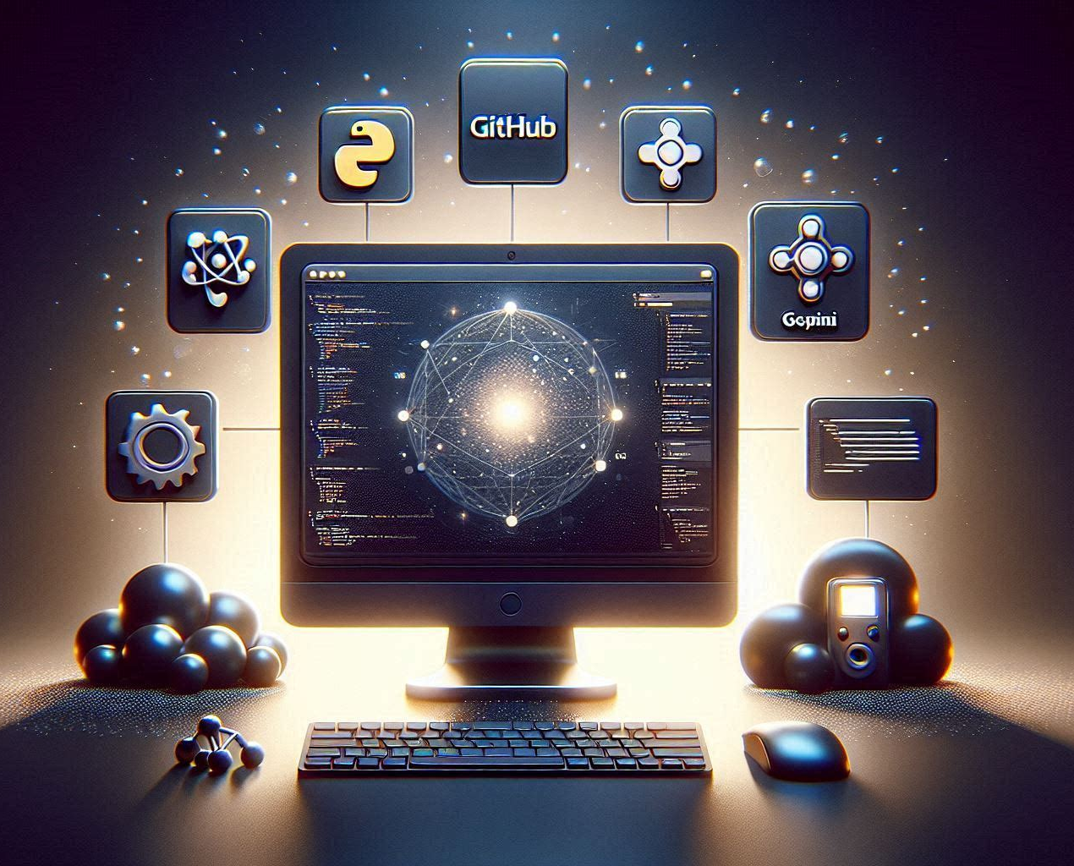
Key Takeaways
Libraries and Frameworks
Different types of Libraries and Frameworks used in Machine Learning with their significance and features.
Jupyter Notebooks and Jupyter Labs
Jupyter Notebooks and Jupyter Labs are popular web-based tools used for Machine Learning.
Cloud Computing Platforms
Google Colab, AWS Sagemaker StudioLab, and Azure Copilot are cloud computing platforms that provide infrastructure, tools, and services for AI development.
GitHub and Hugging Face
GitHub is a web-based platform for version control, code collaboration, and project management.
Notes:
We will begin with an introduction to the different types of Libraries and Frameworks to set the context. Then, we will explore Jupyter Notebooks and Jupyter Labs, Google Colab, AWS Sagemaker StudioLab, Azure Copilot, GitHub, GitHub copilot and Hugging Face in depth and finish with a Summary slide.

Slide 29

Assignments
A03
Understanding the tools of the Trade! Jupyter Notebooks and Jupyter Lab
L03
Practical Exploration of GitHub and Jupyter

